Slide 1



Financial levers
City of Ghent - Indra Van Sande

Slide 2
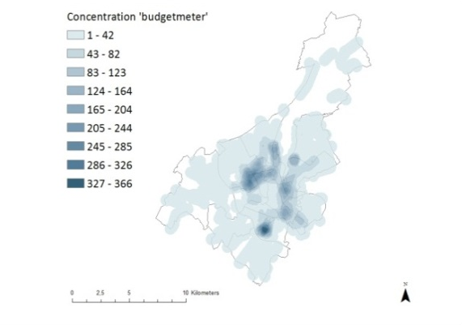
Importance of residential sector
Increasing fuel poverty
24% of total CO₂ emissions
Expected impact of all measures in SEAP: -11% compared to 2011
Number of households connected
to a budget meter in the city of Ghent

Slide 3
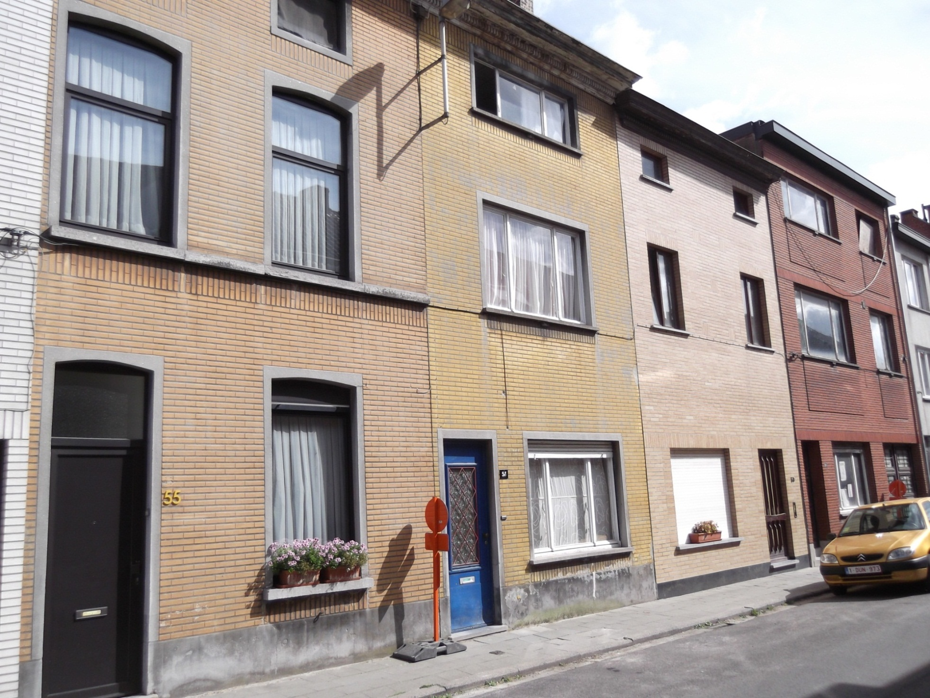

Slide 4
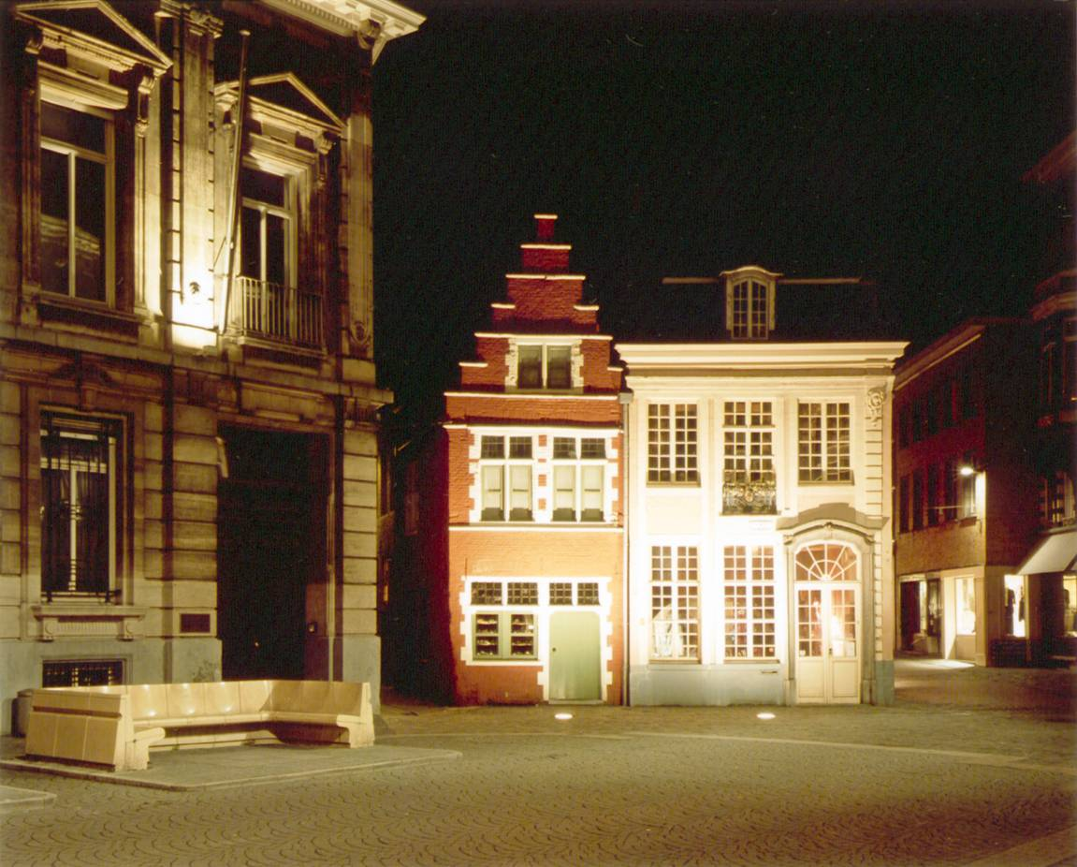

Slide 5
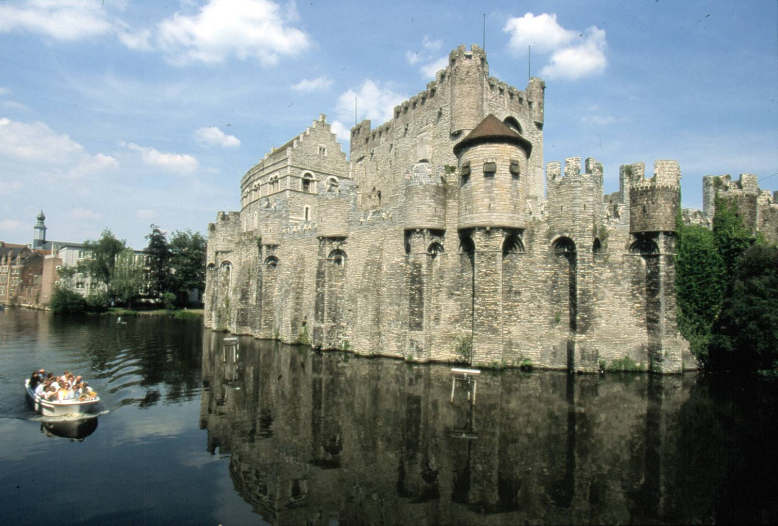
Qualitative living
Ghent climate neutral in 2050?
120.000 dwellings => 3.300 /y
19.000 businesses => 530 /y
600 own buildings => 16 /y

Slide 6
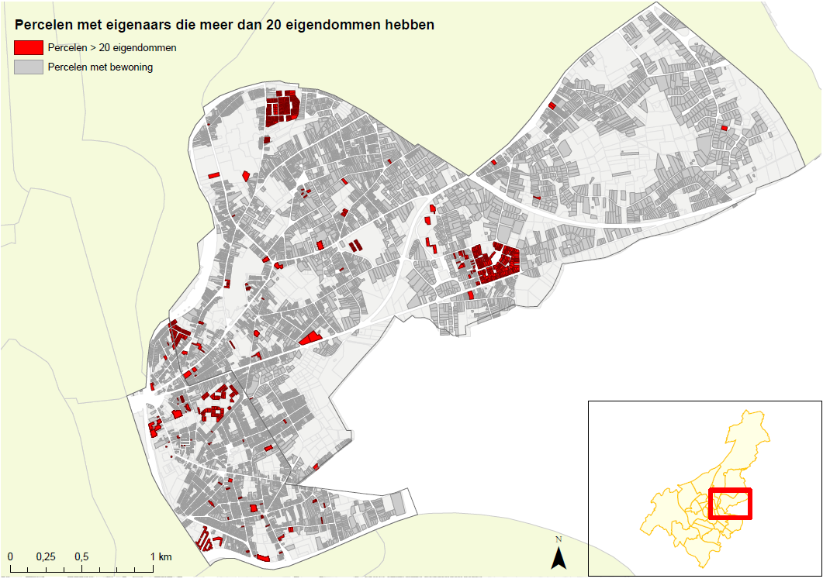
Plots with owners of more than 20 premises

Slide 7



What motivates ?

Slide 8

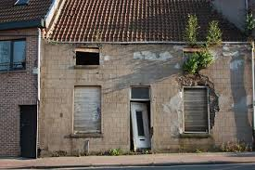



Measures:
Energy susbsidies tailor made on the
income of households
Link with subsidies for qualitative
living
Cheap loans (2%) for energy
investments especially for social weak households (0%)
Subsidies for bottom up projects
of citizens and other stakeholders:
sustainable districts
Crowdfunding and participation
platform
> 8.224.000 €
loans
Duurzame wijken

Slide 9
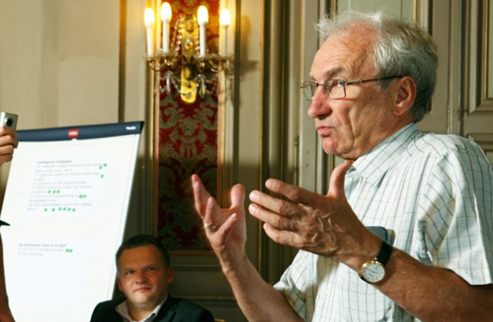
Stakeholder input:
Support mostly for socially weak households
Substantial support
Tackle the rental market too
The support should help people in whatever phase they are of their retrofit project
Retrofit needs to be done in several phases for socially weak households to make it payable or when they can’t take up big loans

Slide 10
Energy subsidies
Owner of 1 house
> €57.884
+ index
Or owner of several houses
< €28.942 + index
Or private social rental
< €34.338 (single)
Or €45.128 (not single)
+ index
< €40.519 (single)
Or €57.884
(not single)
+ index
income
Roof insulation
Supplement (roof)
Roof renewal
Façade insulation
Floor insulation
Insulating windows
Heat pump
Floor heating
Small energy jobs
x
x
x
x
x
x
x
x
x
x
x
x
x
x
x
x
x
x
x
x
x
x
Max. 4.600
Max. 2.500
Max. 1.500
Max. 1.000

Slide 11
Thank you for your attention!

